Slide 1
Languages and tools to create theatre scripts for ROBOT THEATRE

Slide 2
Theory of Robot Theatre?

Slide 3
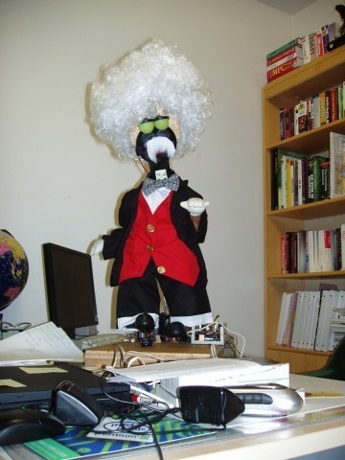
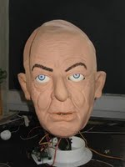
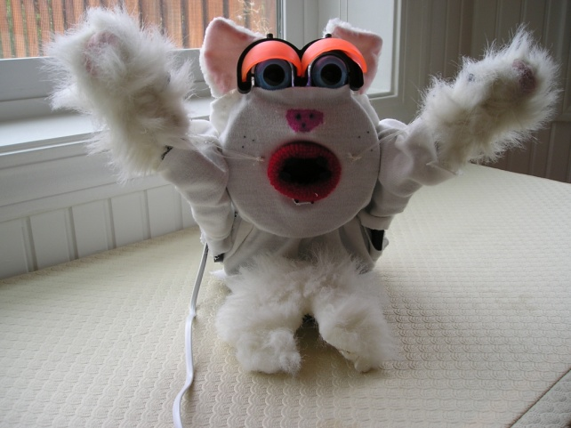
On Synthesis and Verification from Event Diagrams in a Robot Theatre
Marek Perkowski, Aditya Bhutada, Martin Lukac⁺, and Mathias Sunardi
Portland State University, Department of Electrical and Computer Engineering,
⁺Tohoku University, Kameyama Laboratory, Sendai, Japan
Physics Debate Theatre of puppet robots
Dr. Niels Bohr
Professor Einstein
Schrödinger Cat

Slide 4
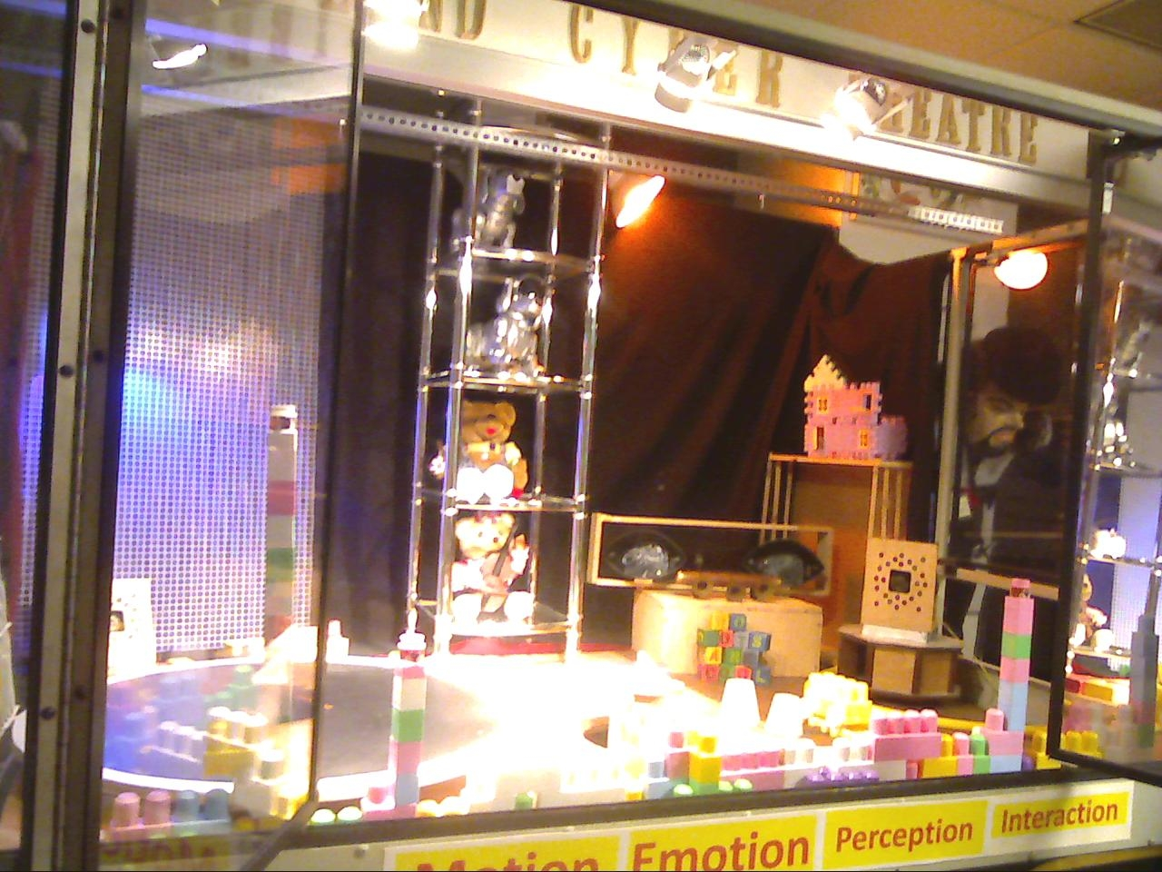
The stage of Portland Cyber Theatre in FAB building

Slide 5
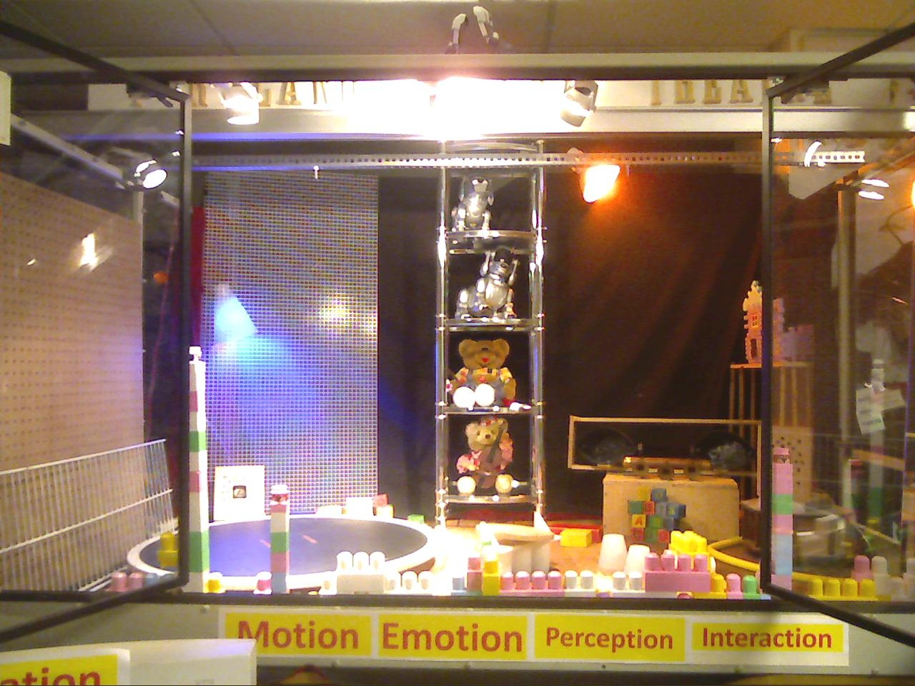
\
Terminology
Perception = Input
Behavior = Input/Output
Motion = Output

Slide 6
Theory of Robot Theatre?
Motion generation:
Motion design for theatre
Natural motion
Motions with symbolic values
Verification of motion, safety
Behavior and script creation
Creation of scripts, generalized events, motions to carry meaning
Perception
Perception of environment (walls, obstacles)
Perception of humans
Perception of objects
Perception of self
Testing and Verification
Self-test of a robot.
Verification of motions
Verification of behaviors
General Theories
Kinematics, inverse kinematics, dynamics
Control
Artificial Intelligence
Formal Verification
Theory of sign
Creation of scripts, generalized events, motions to carry meaning
Machine Learning
Robot Vision
Sensor Integration
Group dynamics
Developmental robots
Interactive Genetic Algorithms
Testing and Fault-Tolerant design
Game Theory

Slide 7
Types of motion editors

Slide 8
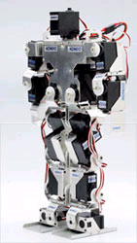
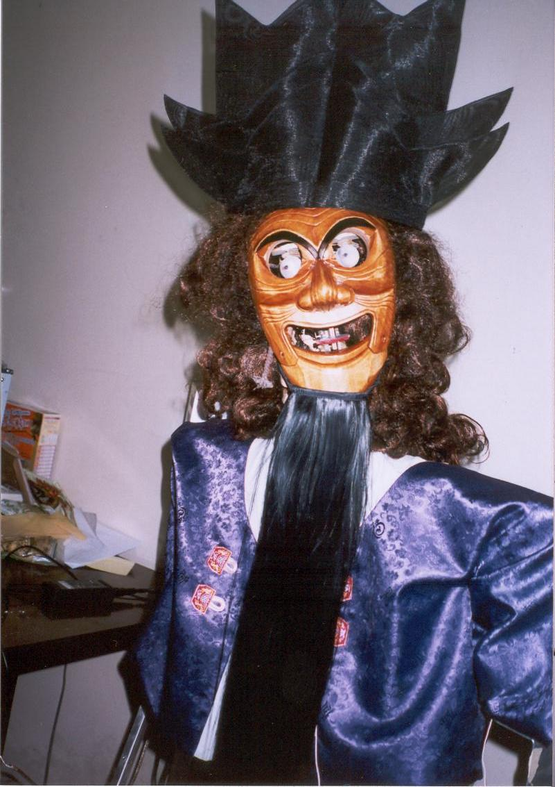
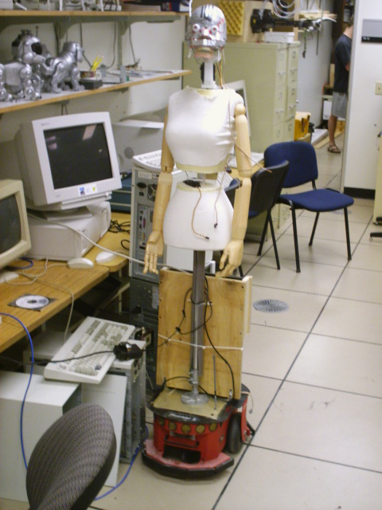
Languages to describe all kinds of motions and events
Labanotation
DAP (Disney Animation Principles) and
CRL (Common Robot Language)

Slide 9
The concept of generalized motions and universal event editor to edit:
robot motions,
behaviors,
lightings and automated events

Slide 10
Motion, evaluation, learning
Motion Problems = examples of correct motions – generalize and modify, interpolate
Mouth Motion
text
Hexapod walking
Distance evaluation
Biped walking
Number of falls
evaluation
Biped Gestures
Comparison to video evaluation
Hand gestures
Subjective human evaluation
Learning problems in Human-Robot Interaction – Motion Generation problems

Slide 11
controller
Robot
Canned code
Editor
Motion language
motion
controller
Robot

Slide 12
Inverse
Kinematics
Forward
Kinematics
Motion Capture
Editor
Motion language
motion
controller
Robot
Evolutionary Algorithms
A very sophisticated system can be used to create motion but all events are designed off-line.
Some small feedback, internal and external, can be used, for instance to avoid robots bumping to one another, but the robots generally follow the canned script.

Slide 13
Universal Event Editor
Motion Capture
Inverse
Kinematics
Forward
Kinematics
Robots
Events language
Lighting
System
Initial events
Universal Event
Editor
events
controller
Sound System
script
Curtain and all equipment

Slide 14
Chameleon box converts sound to light and controls
Universal
motion editor
MIDI
Lights and controlled events

Slide 15
Regular Expressions

Slide 16
Language of Regular Expressions
We create a formal model for robot behavior.
“behavior” = input-output mapping (a relation)
This is called Event Diagram
Input is a sequence of symbols, output is a sequence symbols
Symbols are abstractions.
They are grouped into sets
Thus, sequences of symbols are the language L* of the symbol set S
Symbols for input (input set) I = {a_person, persons, raise_left_hand, head_turn_left, morning, day, evening, car, …}
Symbols for output (output set) O = {shake_head, wave_right_arm, waltz_box_step, waltz_travel, lights_blue_on, lights_blue_off, …}

Slide 17
Event Expressions
Sequence-operational
semantics
Symbols (letters), Iteration (*), Concatenation (.), Union (∪), Negation (¬), Intersection (∩)
Minimum, Maximum, Arithmetic operators, parallel operators
Probabilistic operators, spectral operators
Probabilistic Extended Regular Expressions (Boolean)
All operators extended to paremeterized probabilistic operators
Extended Regular Expressions (Boolean)
Set theoretical semantics
Symbols (letters), Iteration (*), Concatenation (.), Union (∪), Negation (¬), Intersection (∩)
Regular Expressions
GENERALIZATION
Set theoretical semantics
Symbols (letters), Iteration (*), Concatenation (.), Union (∪)

Slide 18
Difference between Set-theoretical and Sequence-operational semantics
(A · B · A · B) ∩ (B · B · A · B) =
(A ∩B) · (B ∩ B) · (A ∩ A) · (B ∩ B) =
φ · B · A · B = φ
In Set-theoretical semantics single difference creates empty set and there is no result of intersection of two motions
(A · B · A · B) ∩ (B · B · A · B) =
(A ∩B) · (B ∩ B) · (A ∩ A) · (B ∩ B) =
φ · B · A · B
In Sequence-operational semantics intersection of two symbols is not empty
Interpreted as “do nothing”, next execute B, next execute A, next execute B

Slide 19
Regular Expressions to specify languages of motions and behaviors
A regular expression is a pattern that matches one or more strings of characters from a finite alphabet.
Individual characters are considered regular expressions that match themselves.
Original regular expressions used union, concatenation and iteration operators.
Regular expressions were next extended by adding negation and intersection to a Boolean Algebra.
Observe that X₁ ∩ X₂ is an empty set for atoms X₁ ≠ X₂ , as the meaning of intersection operator is set-theoretical.
Similarly the interpretation of ∪ operator is set-theoretical in regular expressions, thus new symbols are not being created.

Slide 20
Greeting_1 = (Wave_Hand_Up º Wave_Hand_Down ) (Wave_Hand_Up º Wave_Hand_Down ) * ∪ Wave_Hand_Up º Say_Hello
Which means, to greet a person the robot should execute one of two actions:
Action 1: wave hand up, follow it by waving hand down. Execute it at least once.
Action 2: Wave hand up, next say “Hello”. The same is true for any complex events.
As we see, the semantics of regular expressions is used here, with atomic symbols from the terminal alphabet of basic events {Wave_Hand_Down, Wave_Hand_Up , Say_Hello}.
The operators used here are: concatenation (º), union (∪) and iteration (*). Each operator has one or two arguments.
So far, these expressions are the same as regular expressions.
Initial state
Wave_Hand_Up
Wave_Hand_Up
Wave_Hand_Down
Say_Hello
∈
Wave_Hand_Down
Final state
Wave_Hand_Up

Slide 21
REVIEW OF REGULAR EXPRESSIONS

Slide 22
REVIEW OF REGULAR EXPRESSIONS
A regular expression is a pattern that matches one or more strings of characters (symbols) from a finite alphabet.
A regular expression is composed from operators and atomic symbols/characters (e.g. letters).
A regular expression corresponds to a language with certain grammar that generates this language.
A language is a set of words (i.e. strings/sequences of symbols that are generated by the grammar).
Individual characters are considered regular expressions that match themselves.
The original regular expressions used three operators: union (∪), concatenation (symbol  or nothing. e.g: a  b and ab are equivalent), and iteration (*).

Slide 23
Extension of regular expressions to probabilistic regular expressions
For instance, assuming that concatenation is a deterministic operator and union is a probabilistic operator with equal probabilities of both arguments, there is a probability of ½ that the robot will greet with motion Wave_Hand_Up º Say_Hello .
Assuming that all operators are probabilistic operators with equal probabilities of both arguments, for event expression Wave_Hand_Up º Say_Hello there is a probability of ½ that the robot will greet with one of the following four motions, each with the same probability:
(1) Wave_Hand_Up º Say_Hello ,
(2) Wave_Hand_Up ,
(3) Say_Hello ,
(4) Nothing will happen.

Slide 24
CONVERTING REGULAR EXPRESSIONS TO AUTOMATA

Slide 25
Synthesis with Brzozowski’s Method
Brzozowski’s derivatives of REs serve as a sound method for transformation of regular expressions to DFA/NFA.
This method not only directly converts regular expressions to DFA/NFA, but also elegantly handles extended regular expressions and works for sets of event expressions.
Given E, a regular language over alphabet X, a DFA is derived that accepts all words from the language, and only those words.
All words of E, starting from letter X_{j} є X.
If the letter is removed from the front of each word from the set, a new language is created, referred to as left-side-derivative of language E by letter X_{j}.
This new language is now denoted by E/X_{j}.

Slide 26
Brzozowski’s derivatives
All words of E, starting from letter X_{j} є X. If the letter is removed from the front of each word from the set, a new language is created, referred to as left-side-derivative of language E by letter X_{j}.
This new language is now denoted by E/X_{j}.
A derivative for word s = X_{i1}, X_{i2}…X_{in} is defined as follows:
E/X_{j} = {s є X* : X_{j}s є E}.
As inherent laws of Brzozowski’s derivative method, the following properties P_{i} always hold true.

Slide 27
Recursive Rules for Brzozowski derivatives
P1. X_{i}/X_{j} = e for i = j
= ø for i ≠ j
P2. (E₁ ∪ E₂)/X_{i} = E₁/X_{i} ∪ E₂/X_{i}
P3. ∈(E) = e when e ∈ E
= ø when e ∉ E
P4. E₁E₂/X_{i}=(E₁/X_{i})E₂∪∈ (E₁)(E₂/X_{i})
P5. E/s=E₁/X_{i1}X_{i2}…X_{in}=[[E/X_{i1}]/X_{i2}]…]/Xi_{n}
P6. E*/Xi = (E/X_{i})E*
P7. E/e = E
P8. (E₁ ∩ E₂)/X_{i} = (E₁/X_{i}) ∩ (E₂/X_{i})
P9. (-E)/X_{i} = -(E/X_{i})

Slide 28
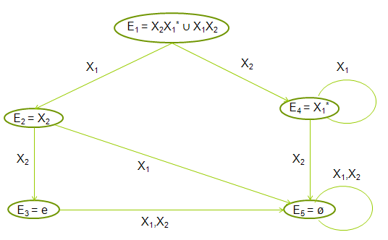
Synthesis example for language (X₂X₁* ∪ X₁X₂).
Applying the left-side-derivative with respect to first character in string, X₁
E₁/X₁ = (X₂X₁* ∪ X₁X₂)/X₁ = (X₂X₁*)/X₁ ∪ (X₁X₂)/X₁
by P2 = (X₂/X₁)X₁* ∪ ∈ (X₂)X₁* ∪ (X₁/X₁)/X₂ ∪ ∈ (X₁)(X₂/X₁)
by P4 = ø X₁ ∪ ø(X₁/X₂) ∪ eX₂ ∪ ø ø
by P1 = X₂
Graph for regular language E₁ = (X₂X₁* ∪ X₁X₂).
This graph can be interpreted as PMG, EEAM or BM depending on meaning of symbols X_{i} and nodes (states)

Slide 29
Languages to describe motions of humanoid robots

Slide 30
Regular Expressions, Boolean and Fuzzy Logic plus many new operators
Most importantly, EDs create counterpart probability operators for all these deterministic operators.
They can be used for event acceptance or event generation.
The diagrams are intended to simulate robot controllers and verify their correctness and properties.

Slide 31
Basic Definitions
A behavior is formally defined as a certain mapping between sets of sequences of input symbols and sets of sequences of output symbols.
Input symbols are formed based on readings from sensors and cameras
Output symbols represent elementary robot/theatre behaviors such as humanoid robot’s arm-up motion or a rotation of the stage of the theatre synchronized with changing lights.
SYMBOL = [NAME, VALUE]
A symbol corresponds to:
a name of input, e.g.: Sensor1, and may have values of: an integer, “undefined” or “don’t care”.
Symbol can also denote an output head_rotation with numerical value of a rotation angle.
An elementary motion is a sequence of input or output symbols.
A motion is a set of elementary motions (finite or infinite).

Slide 32
Concept of motion is very general here
Here our interested in the motion subsystem design.
We use the term “motion” to represent a very broad concept that includes (partially) coordinated motions of many robots and automated stage segments.
These include:
furniture,
sounds,
music,
lights,
smoke machines,
curtain rising and dropping,
etc.
The synchronization in EDs may be deterministic or probabilistic.
The synchronization in EDs may be partial or complete. The motions can be “partially coordinated”

Slide 33
General formalism
Our approach is a general formalism to generate, realize and verify generalized events/motions.
The diagrams and their algebra can be applied to:
the simulated agents in movie animation and computer games,
the physical robots with material bodies.
Literature presents many interesting small robots that can be used in a theatre.
We illustrate our system on the humanoid biped robots KHR-1 and iSOBOT with speech, sounds, music and lights in Portland Cyber Theatre.

Slide 34
Two Semantics for Operators
There are also two semantics for operators in our diagrams:
Set-theoretical, in which we only create sets of motions from basic motions (new numerical values for basic motions cannot be created.
The values will remain the same).
This is similar to regular expressions and extended regular expressions.
Hybrid-automata based, in which additional new basic motions are created by some operations on symbol values in our diagrams.
This is a significant generalization of regular expressions.
These new motions can be only new parameters of existing motions (such as speed or angle) or encodings of completely unused so far motions.

Slide 35
Motion Editing with Interaction and Languages

Slide 36
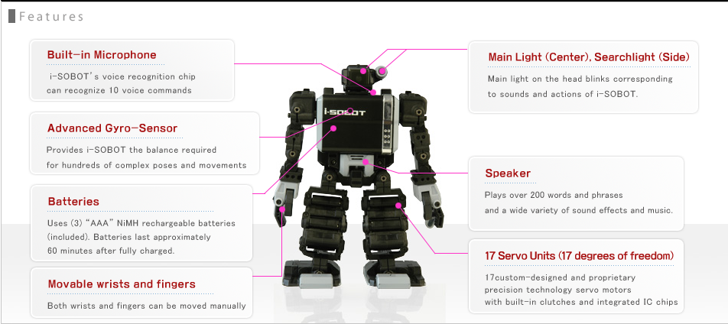
iSOBOT robot actor

Slide 37
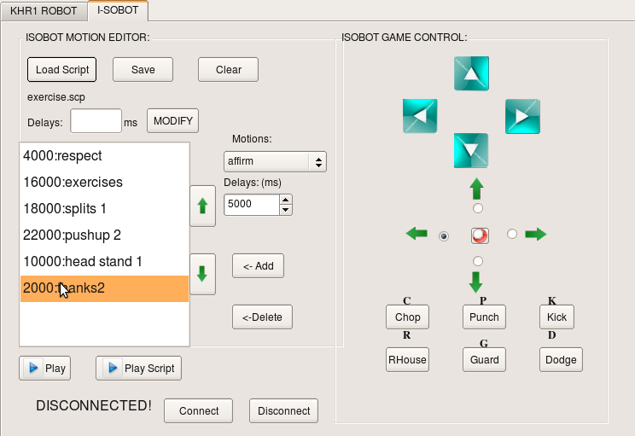
iSobot Motion Editor Interface

Slide 38
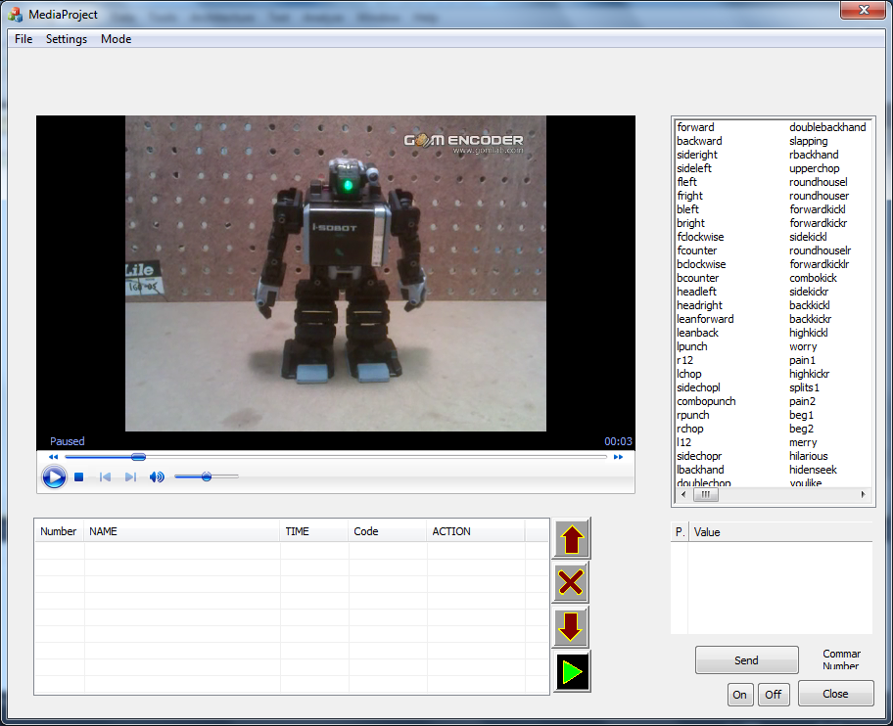
Editor with integrated video, text to speech and probabilistic regular expressions editing
Embedded Windows Media Player interface within editor

Slide 39
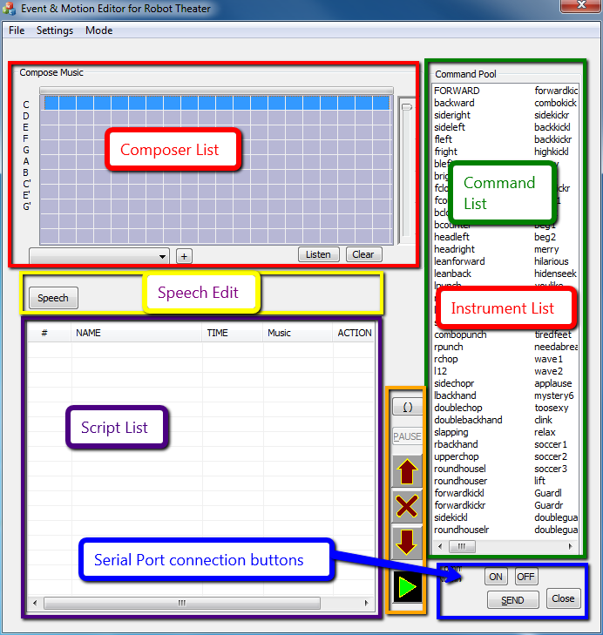
Motion Editor GUI

Slide 40
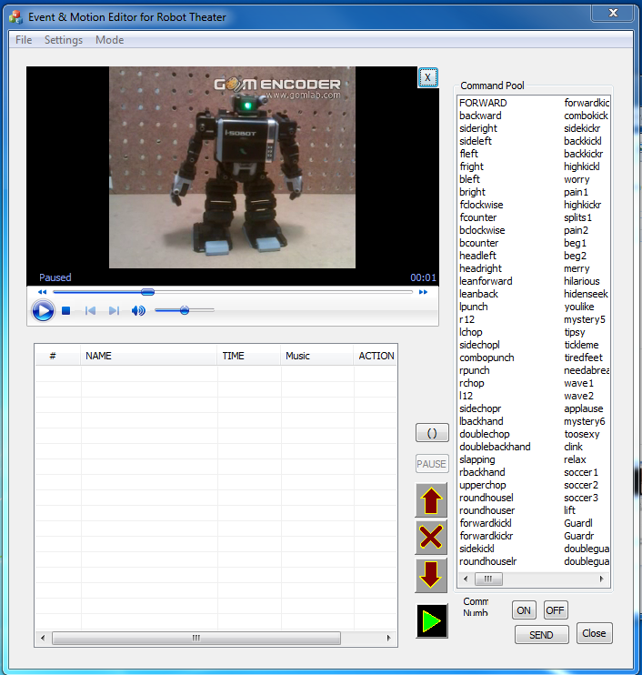
Embedded Windows Media Player

Slide 41
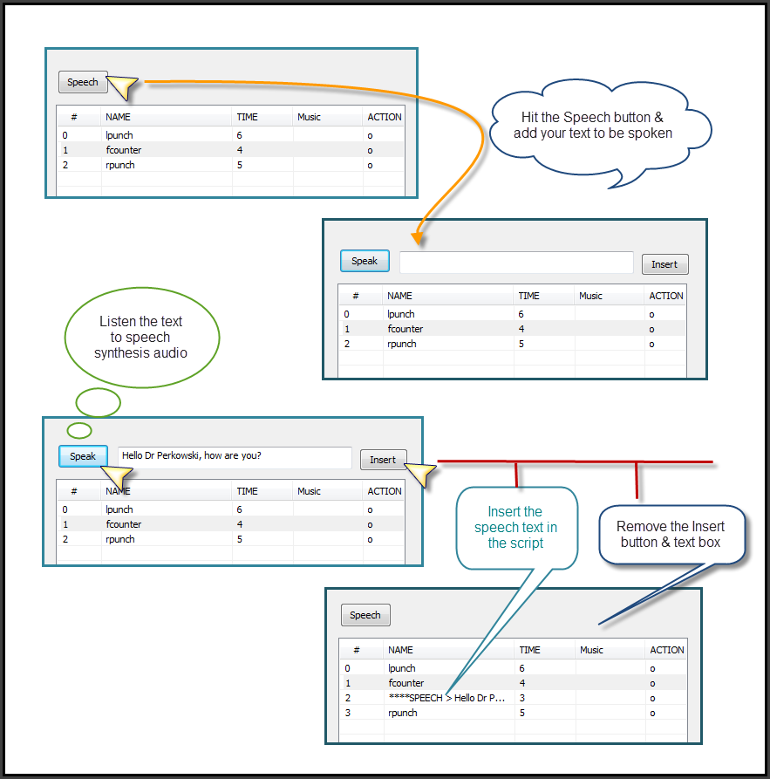
Add speech text within script list

Slide 42
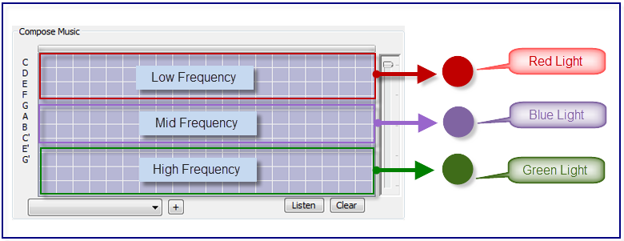
Composer has different frequency range, lighting up different lights

Slide 43
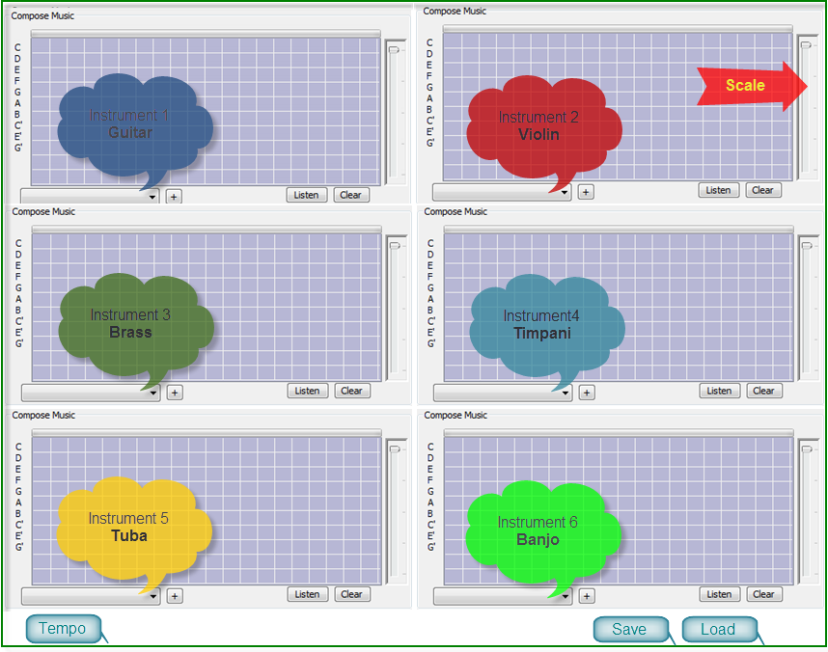
Idea for a MIDI interface with different instrument selection option

Slide 44
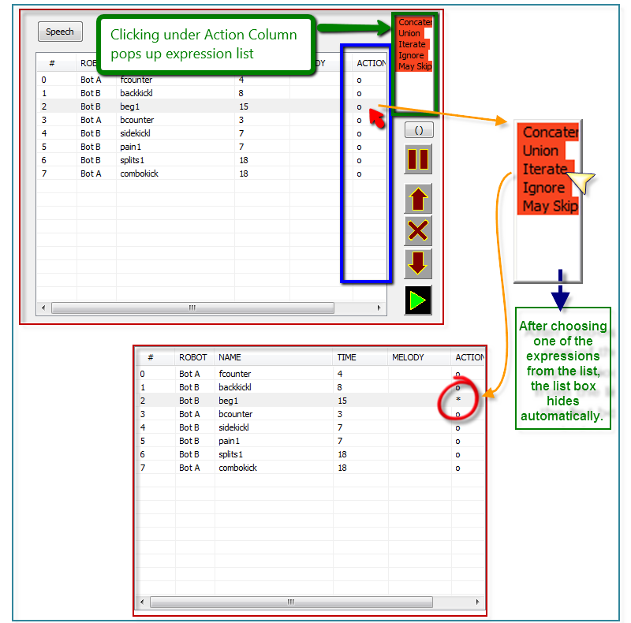
Interface for adding Regular Expressions

Slide 45
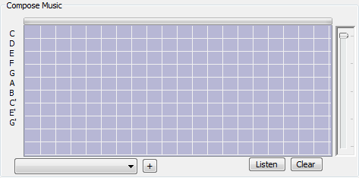
GUI for MIDI Composer

Slide 46
KHR-1 and iSobot Motion Editor Interface

Slide 48
Generating Emotional Motions

Slide 49
Spectral filtering
Matched filters
Hermite interpolation
Spline Interpolation
Wavelets
Repetitions
Mirrors

Slide 51
Editor of wwaveforms

Slide 52
Event Expressions and Language REBEL

Slide 53
Event Expressions
Tool to design motions directly from symbols.
This theory is general enough to allow arbitrary motion to be symbolically described but is also detailed enough to allow the designer or the robot to precise the generated behavior to the most fundamental details.
Our main concept is that the motion is a sequence of symbols, each symbol corresponding to an elementary action such as shaking head for answering “yes”.
We will call them primitive motions.
The complex motions are created by combining primitive motions.

Slide 54
Greeting_1 = (Wave_Hand_Up º Wave_Hand_Down ) (Wave_Hand_Up º Wave_Hand_Down ) * ∪ Wave_Hand_Up º Say_Hello
Which means, to greet a person the robot should execute one of two actions:
Action 1: wave hand up, follow it by waving hand down. Execute it at least once.
Action 2: Wave hand up, next say “Hello”. The same is true for any complex events.
As we see, the semantics of regular expressions is used here, with atomic symbols from the terminal alphabet of basic events {Wave_Hand_Down, Wave_Hand_Up , Say_Hello}.
The operators used here are: concatenation (º), union (∪) and iteration (*). Each operator has one or two arguments.
So far, these expressions are the same as regular expressions.
Initial state
Wave_Hand_Up
Wave_Hand_Up
Wave_Hand_Down
Say_Hello
∈
Wave_Hand_Down
Final state
Wave_Hand_Up

Slide 55
Event Expressions

Slide 56
Event Expressions
We further extend the ERE to Event Expressions (EE), which we realized conceptually as Event Diagrams (ED).
The relation between Event Expressions and Event Diagrams is similar to the relation between Boolean Expressions and Binary Decision Diagrams.
In general, EEs are multi-input and multi-output.
Similar to EREs, EEs can be mapped directly to sequential networks or (deterministic, non-deterministic or probabilistic) automata.
Event Expressions
Event Diagrams
Boolean Expressions
Binary Decision Diagrams

Slide 57
Set-theoretical semantics of regular expressions
Observe that for two atoms, the intersection X₁ ∩ X₂ is an empty set when atoms X₁ ≠ X₂, as the meaning of intersection operator is set-theoretical.
Thus, similar to other operators of ERE, the intersection does not create new symbol values in EEs and EDs.
Such expressions can then be used to create sets of motions where numeric values of atomic symbols are basic motions, known to the system that interprets symbolic motions on a robot.
While a concatenation of atoms describes a single motion, an ERE describes a set of motions (i.e. behaviors) where all of them use the atomic motions from some finite library.
This can be further extended to an infinite library, in which the atomic motions can be enumerated as: a₁, a₂, a₃, … a_{n}, for any value of n.

Slide 58
The interpretation that is not set-theoretical
Similarly the interpretation of the union (set sum, or ∪) operator is set-theoretical in regular expressions, thus new values are not created, only sets of motions are increased.
It is not so in the Hybrid Automata interpretation of PEG, where some operators like the “truncated sum” create new values.
2 + 2 = 3 in modulo 4 system
The intersection X₁ ∩ X₂ can be now enhanced with fuzzy operator (X₁ min X₂) which for atoms X₁ ≠ X₂ creates a non-empty value min(X₁, X₂) as the meaning of this type of “generalized intersection operator” is no longer set-theoretical.
This fact creates a new semantics for our diagrams and adds expressive power to them.

Slide 59
Verification of motions
The new values created in Hybrid Automata may exceed some geometric constraints for variables:
a robot can for instance hit his head with his arm.
The generated motions must be verified in order not to hit an audience member or not to damage a robot.
Verification is also used to fit the constraints of the space.
If expression E1 describes all “waltz dances” of a mobile robot and expression E2 describes motions in a narrow corridor intersection, the set-theoretical expression E1∩E2 describes all ways for the robot to dance waltz in this narrow space without hitting the walls.

Slide 60
The basic ideas of event expressions
Symbol is represented by name and value, e.g.: X₁ or X=1.
Symbol is a basic event or a set of basic events that are:
recognized in parallel
or synchronized and executed in parallel.
Symbols can be connected in parallel.
For instance:
(a) text spoken,
(b) leg motion, and
(c) hand motion
can be created independently and combined in parallel for synchronized execution.
Connecting symbols in parallel creates new symbols that correspond to macros or subroutines.

Slide 61
Symbols executed in parallel and in series
Symbols executed in parallel are denoted as [symbol1, symbol2] or symbol1 par symbol2.
Symbols can be connected in series; we call this symbol concatenation, which is also the base operator of our representations.
Concatenation (·) is also a main concept of Regular Expressions.

Slide 62
Creating new motions
To create a new motion, the human animator has to do the following:
Know the set of basic symbols and their value intervals.. (This can be a large library in which every basic motion is described by a name or visualized, see Fig. 1.)
Select the symbols and combine them in parallel.
This means that these basic actions are executed in parallel, being synchronized in the starting moment.
Give new names to these combined actions.
Concatenate the symbols (or use other operators).
Give new names to concatenations (optional).
Proceed recursively and hierarchically, creating higher and higher behaviors in the hierarchy.
Use all operators of the system; the deterministic operators for deterministic components of behaviors and the non-deterministic, probabilistic operators for the partially random behaviors after parallelized?

Slide 63
Thinking in term of sets of motions: hand waving example
When creating the generalized events, it is often more convenient to think in terms of sets of motions rather than single motions.
For instance: a greeting motion of a humanoid robot can be described as the regular expression:
Greeting = (Wave_Hand_Up  Wave_Hand_Down)  (Wave_Hand_Up  Wave_Hand_Down )* ∪ Wave_Hand_Up  Say_Hello
Or, equivalently:
Greeting = W₁W₁* ∪ W_{up} S_{Hello}
where:
W₁ = (Wave_Hand_Up  Wave_Hand_Down)
W_{­up­} = Wave_Hand_Up
S_{Hello} = Say_Hello

Slide 64
Thinking in term of sets of motions: hand waving example (cont)
Standard values of variables are used here so they are not shown (a non-standard value would look like (Wave_Hand=3)).
Which means, to greet a person, the robot should execute one of two actions: Action 1: “wave hand up, follow it by waving hand down” (W₁).
Execute it at least once (W₁W₁*) OR (∪) Action 2: “Wave hand up, next say “Hello”” (W_{up}S_{Hello}).
Observe that this expression has an infinite number of possible executions, or a very high number (dependent on the definitions of the probabilistic operators: , * , ∪, see below)
The same is true for any complex event.

Slide 65
The RE semantics of the generator in this example
The semantics of RE is used in the above example, with atomic symbols from the terminal alphabet of basic events {Wave_Hand_Down, Wave_Hand_Up , Say_Hello}.
The operators used in the Greeting expression above are: concatenation (), union (∪) and iteration (*).
Each operator had one argument (iteration) or two arguments (concatenation and union).
So far, these expressions are the RE.

Slide 66
Extending to Event Expressions
They are now expanded to event expressions by recursively adding more deterministic and probabilistic operators on event expressions
For instance, if we agree that the meaning of every operator in Greeting_1 is that it executes its first argument with probability ½ and its second argument with the same probability, each possible sequence from the infinite set of motions of Greeting_1 will have certain probability of occurrence.
One can create event expressions using both deterministic and probabilistic, single-argument and two-argument operators.

Slide 67
Creating probabilistic operators in EEs
Every standard operator can be extended to many probability operators, based on numerical assumptions of selecting its arguments in synchronous time.
For instance, if we agree that the meaning of every operator in Greeting is that it executes its first argument with probability ½ and its second argument with the same probability (the joint probability sums up to 1), each possible sequence from the infinite set of motions of Greeting will have certain probability of occurrence.
Another probabilistic operator corresponding to ∪ can assume that the first argument is executed with probability 1/3 and the second argument with probability 2/3, etc.

Slide 68
Deterministic and probabilistic interpretation of operators
One can create event expressions using any of deterministic and probabilistic, single-argument, two-argument and multi-argument operators (like in programming language LISP).
The operators in classical regular expressions and in extended regular expressions are deterministic.
However, in Event Expressions we can give both deterministic and probabilistic interpretation to the operators, according to their extended names, such as the probabilistic operator ∪_{1/2} for equal probabilities of arguments.

Slide 69
Acceptor, generator and transformer
Observe that this graph can be interpreted as an acceptor, when symbols Xi are inputs.
It can be interpreted as a generator when symbols Xi are outputs.
The graph can be thus used to recognize if some motion belongs to some language and can generate a motion belonging to the language.
This graph is realized in software

Slide 70
Dance, rituality and regularity
Dances of groups of robots are already very popular
In most cases all robots do the same, or there are few groups of robots programmed identically.
It would be interesting to investigate some recursive and iterative patterns, similar to behaviors of flocks of birds and of bees in which emergent behavior can adaptively change one form of regularity to another form of regularity.

Slide 71
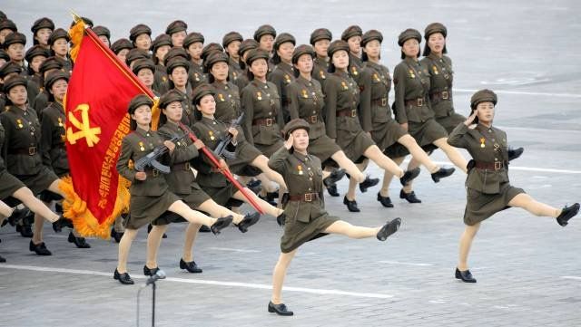
Dance, rituality and regularity
…….change one form of regularity to another form of regularity…….

Slide 72
Probability Event Generator (PEG)

Slide 73
Probability Event Generator (PEG)
Behavior Machine
(CSM)
Probabilistic Event Generator (PEG)
Motion
User (Re)Actions
Event Expression Accepting Machine (EEAM)

Slide 74
Motions
Behavior Machine
(CSM)
Probabilistic Event Generator (PEG)
Motion
User (Re)Actions
Event Expression Accepting Machine (EEAM)

Slide 75
Recursive Rules for PMG design
P1. X_{i}/X_{j} = e for i = j
= ø for i ≠ j
P2. (E₁ ∪ E₂)/X_{i} = E₁/X_{i} ∪ ∈ E₂/X_{i}
P3. ∈(E) = e when e ∈ E
= ø when e ∉ E
P4. E₁E₂/X_{i}=(E₁/X_{i})E₂∪∈ (E₁)(E₂/X_{i})
P5. E/s=E₁/X_{i1}X_{i2}…X_{in}=[[E/X_{i1}]/X_{i2}]…]/Xi_{n}
P6. E*/Xi = (E/X_{i})E*
P7. E/e = E
P8. (E₁ ∩ E₂)/X_{i} = (E₁/X_{i}) ∩ (E₂/X_{i})
P9. (-E)/X_{i} = -(E/X_{i})
P10. (E₁ max E₂)/X_{i} = (E₁/X_{i}) max (E₂/X_{i})
In our system there are many other rules similar to rule P10 for MIN, MAX and other MV operators.
There are many rules similar to P9 for literals and rules similar to P8, P2, P6 and P4 for probabilistic variants of operators ∩,∪, and concatenation, respectively

Slide 76
Derivation rules for Event Expressions
Observe, that the machine realized according to these rules can be realized both as an acceptor and as a generator.
The derivation-based system can include many other rules similar to rule P10 for MIN, MODSUM and other MV/fuzzy/arithmetic/time operators. For instance:
P10. (E₁ max E₂)/X_{i} = (E₁/X_{i}) max (E₂/X_{i})
P10A. (E₁ min E₂)/X_{i} = (E₁/X_{i}) min (E₂/X_{i})
P10B. (E₁ trunc-sum E₂)/X_{i} = (E₁/X_{i}) trunc-sum (E₂/X_{i})
P10C. (E₁ parallel E₂)/X_{i} = (E₁/X_{i}) par (E₂/X_{i})
P10D. (E₁ mod-add E₂)/X_{i} = (E₁/X_{i}) mod-add (E₂/X_{i})
P10E. (E₁ div E₂)/X_{i} = (E₁/X_{i}) div (E₂/X_{i})
There are many rules similar to P9 for literals and rules similar to P8, P2, P6 and P4 for probabilistic variants of operators ∩,∪, and concatenation, respectively (their meaning has been explained in section 3).

Slide 77
Verification of Motions
A PEG verification is similar to the reachability analysis
It allows finding all NFA node labels that are included in the same final DFA state set (nodes executed in the same moment).
A contradiction is found if some symbols, states or outputs that should not exist in parallel, exist together in one DFA node.
If such a contradiction is found, the user has to modify the initial PEG specification and repeat the procedure.

Slide 78
Creating safe behaviors
Dancing waltz = b * c * a * d *
Narrow corridor = Right ¹⁰
Dancing waltz in narrow corridor = (b * c * a * d *) ∩ Right ¹⁰

Slide 79
Creating safe behaviors

Slide 80
Interaction Theatre
Actors: robots
Directors: none
Public: feedback
Action: not fixed
Example: Hahoe

Slide 81
Behavior Learning Architecture for Interaction Theatre
Motion
Machines
Perception Machines
Output text _{i}
Input text from keyboard
Face Detection and Tracking
Output speech _{i}
Face Recognition
Behavior Machine
Output robot motion _{i}
Facial Emotion Recognition
Hand gesture recognition
Output lights _{i}
Sonar, infrared, touch and other sensors
Output special effects _{i}
Robot architecture is a system of three machines: motion machine, perception machine and brain machine
Speech recognition
Output sounds _{i}

Slide 82
Improvisational Theatre
Actors: robots
Directors: humans
Public: no feedback
Action: not fixed
Example: Schrödinger Cat

Slide 83
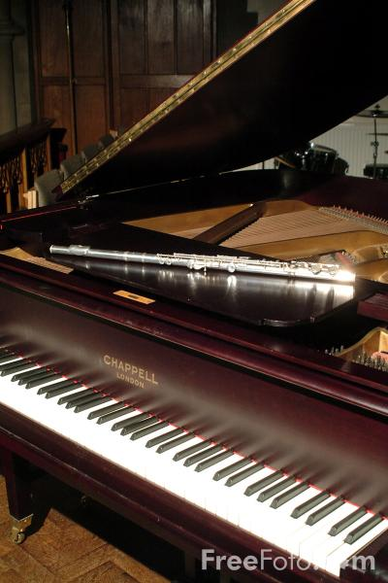
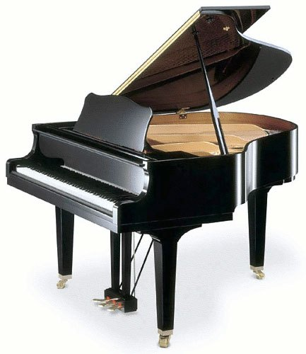
Improvisational Theatre “What’s That? Schrödinger Cat”
Schrödinger Cat
Professor Einstein
Motion _{e1}
Motion _{c1}
Motion _{e2}
Motion _{c1}
Motion _{cm}
Motion _{en}
Motions of Schrödinger Cat
Siddhar
Motions of Einstein
Arushi

Slide 84
Universal Behavior Editors for Robot Theatre

Slide 85
Our model of robot architecture
For every individual robot but also for the entire robot theatre, architecture is a system of three subsystems:
The perception subsystem, which transforms images or other sensor information into vectors of basic features, and maps sets of those vectors to some symbolically recognized objects.
We describe this subsystem using special type of ED called the Perception Event Diagrams (PED).
The behavior subsystem, which uses stored state information and patterns of symbolic input objects to map the robot’s perceptions and memories into actions.
This subsystem is described using the Behavioral Diagrams (BD).
The motion subsystem, which describes what the audience perceive during the performance, such as: motions, sounds, lighting, visual/special effects.
This subsystem is described using the Probabilistic Event Generators (PEG).

Slide 86
Universal Perception Editor
Principal Component
Analysis
Neural Nets
cameras
Speech input
Constructive
Induction
Various Feature
Extracting
Methods
Sensors
Clustering
Perception Editor
Examples – input output pairs

Slide 87
Feedback from the environment
controller
Robot
The environment includes:
Other robots
Human actors
Audience
The director
controller
Robot
Critic

Slide 88
Reversibility of input and output
The reversibility of the human’s behavior and the robot’s behavior that mimics this human.
A sequence like “left hand up - next right hand down” can be an input sequence of an acceptor machine or an output sequence of a generator machine.
generator machine
left hand up - next right hand down
acceptor machine

Slide 89
Reversibility
Because of reversibility, this expression can apply both:
to a robot recognizing actions of a human (the acceptor semantics)
or to a robot trying to imitate the human’s behavior (the generator semantics).

Slide 90
Behavior Machine (Complex State Machine)

Slide 91
Behavior Machine (Complex State Machine)
Behavior Machine
(CSM)
Probabilistic Event Generator (PEG)
Motion
User (Re)Actions
Event Expression Accepting Machine (EEAM)

Slide 92
Universal Perception Editors for Robot Theatre

Slide 93
Perception Automaton
Motion Generator Automaton
Say hello, wave hand
Say hello, wave hand
Accept Hello
Generate Hello
Accept handshake
Generate handshake motion
Greeting completed
Greeting completed

Slide 94
Perception
Face Recognition as a learning problem
Face Image 1
John Smith
Face Image 2
Face Image 3
Marek Perkowski
Face Image 4

Slide 95
Face Emotion (Gesture) Recognition as a learning problem
Face Emotion Recognition as a learning problem
Face Image 1
happy
Face Image 2
Face Image 3
sad
Face Image 4
Face
person

Slide 96
Recognition Problems = Who? What? How?
Face
person
Face
emotion
Face
age
Face
gender
Face
gesture
Learning problems in Human-Robot Interaction – Perception problems

Slide 97
Event Expression Accepting Machine (EEAM)

Slide 98
Event Expression Accepting Machine (EEAM)
Behavior Machine
(CSM)
Probabilistic Event Generator (PEG)
“Motion”
User (Re)Actions
Event Expression Accepting Machine (EEAM)

Slide 99
Event Expression Accepting Machine (EEAM)
Event Expression (EE):
At its core, it is a Regular Expression
Naturally, this can be extended to non-regular languages, and fuzzy regular expressions.
Formally, EE is a set of a finite set of Symbols (S) and Operators (O): <S,O>
The term “symbol” is loosely used; it is not a single character like the alphabet, but something to represent a single action or behavior. For example: “Wave_Hand_Up” is an action symbol, “Say_Hello” is an action symbol, “Avoid_Obstacle” is a behavior symbol, “Explore” is a behavior symbol.
A set of actions can also be grouped as one symbol.
The basic set of Operators for EE are: concatenation (•), union (∪), iteration/repetition (*), negation (¬), and intersection (∩).

Slide 100
Event Expression Accepting Machine (EEAM)
Event Expression Operators:
Concatenation (•):
Example: EE: Wave_Hand_Up • Say_Hello Meaning: “wave hand up gesture followed by saying ‘Hello’”
Union (∪):
Example: EE: Wave_Hand_Up ∪ Say_Hello Meaning: “Either waving hand up OR saying ‘Hello’, but not both”
Iteration/repetition (*):
Example: EE: Wave_Hand_Up* • Say_Hello Meaning: “Do wave hand up gesture zero or more times, followed by saying ‘Hello’”
For limiting sake, repetition is limited up to 4 times.

Slide 101
Event Expression Accepting Machine (EEAM)
Event Expression Operators:
Negation (¬):
Example: EE: ¬Wave_Hand_Up ∪ Say_Hello Meaning: “Anything BUT waving hand up OR saying ‘Hello’” Note: In this sense, ¬ is a set operator
Intersection (∩):
Example: EE: Waltz_Box_Step ∩ Avoid_Obstacle Meaning: “Do a the ‘box step’ pattern of waltz, but don’t run into things!” Note: In this sense, ∩ is used as supplementing an action with a safety behavior

Slide 102
Various Types of Event Expressions
A recognized pattern, perception, “word”
The “Family” of action to perform
Behavior Machine
(CSM)
Probabilistic Event Generator (PEG)
Motion
User (Re)Actions
Event Expression Accepting Machine (EEAM)
Performed Motion(s)
Perception,
Sequence of inputs from user
Commands to robot, lighting, set

Slide 103
Acceptor, generator and transformer
Observe that this graph can be interpreted as an acceptor, when symbols Xi are inputs.
It can be interpreted as a generator when symbols Xi are outputs.
The graph can be thus used to recognize if some motion belongs to some language and can generate a motion belonging to the language.
This graph is realized in software

Slide 104
Processes
(2) User inputs are preprocessed (e.g. facial detection, gesture detection, etc.) The sequence of inputs is matched with “known paterns”
(Event Expressions)
(3) BM/CSM deterministically decide the proper response to user’s input (EE)
(5) PEG translates BM/CSM output into actions. If there are probabilistic operators, then actions are generated according to the probabilty
(4) The selected response is also an EE
Behavior Machine
(CSM)
Probabilistic Event Generator (PEG)
“Motion”
User (Re)Actions
Event Expression Accepting Machine (EEAM)
(6) PEG also validates if the selected/generated action is possible
(8) Robots, lighting, sound effects are dancing, flashing, playing, etc
(7) Translated actions are: joint angles, on/off, music to play, etc.
(1) User (audience) interact with system: facial gestures, hand gestures, speech, etc…

Slide 105
User Interaction
Behavior Machine
(CSM)
Probabilistic Event Generator (PEG)
“Motion”
User (Re)Actions
Event Expression Accepting Machine (EEAM)

Slide 106
User Interaction
Any kind of user input you can think of:
Facial gesture recognition
Body (arm, hand, torso) gesture recognition
Speech recognition
For example:
User says “Hello” while waving her right arm
User smiles and says “Good morning”
System waits until user completes gesture/input before processing
When no gesture/input detected for a few moment, that’s a signal for the end of the input sequence
Note: using EE, system can be designed to recognize very short (i.e. one input) or very long (infinitely long) sequence of gestures
What is the appropriate/acceptable “wait time”? 1 seconds? 2 seconds?

Slide 107
Conclusions
We presented the concept of completely automated robot theatre with single editor and language
Event expressions allow to create sets of interrelated (similar) motions, which makes for more interesting robot behaviors.
Motions can be verified
We hope that Probabilistic Regular Expressions and General Event Expressions can find some applications outside robot theatre

Slide 108
A question
Can you propose other types of robots and devices that can create an interesting theatre?

Slide 109
Types of robot theatre

Slide 110
Realizations of Robot Theatres
Animatronic “Canned” Robot theatre of humanoid robots
Disneyworld, Disneyland, Pizza Theatre
Theatre of mobile robots with some improvisation
Ullanta 2000
Theatre of mobile robots and humans
Hedda Gabler , Broadway, 2008
Phantom in Opera, 2008
Switzerland 2009

Slide 111
Animatronic Theatre
Actors: robots
Directors: none
Public: no feedback
Action: fixed
Example: Disney World

Slide 112
Theatre of Robots
and Actors (contemporary)
Actors: robots
Actors: humans
Directors: humans
Public: traditional feedback, works only for human actors
Action: basically fixed, as in standard theatre

Slide 113
Theatre of Robots
and Actors (future)
Actors: robots
Actors: humans
Directors: humans + universal editors
Public: traditional feedback, like clapping, hecking, works for both robot and human actors
Action: improvisational, as in standard improvisational theatre

Slide 114
A question
Can you propose other types of robot theatre than those discussed above?

Slide 115
Conclusions
It is an important topic how to describe motion for a robot.
Behavior is input-output relation between sensors and effectors. It generalizes motion and can be described in similar ways.
Various editors and robot languages are used to describe motions and behaviors.
Concepts from language theory, computer science, control, language design, Digital Signal Processing can be used.
Various models of robot theatre are possible. Each would require a different type of editor.

Slide 116
Questions and Problems (1)
What kind of theories are used or can be used for developing a complete theatre of autonomous interactive improvisational robots that would act together with humans?
Propose a new theory- research area for robot theatre, explain what it will bring to the robot theatre as intended above.
Describe some examples of robot motion and robot behavior editors.
Propose a new type of an editor based on some software area that you are familiar with.
Define regular languages
Give example of a regular language and a machine accepting this language.
Discuss possible extensions to classical regular languages.
Why regular languages and their extensions are useful for robotics?
What is the relation between regular languages and automata?
Explain the difference between Set-theoretical and Sequence-operational semantics

Slide 117
Questions and Problems (2)
Using Brzozowski’s Method convert a regular language a* (bb)* + b* (aa)* to an automaton.
Find some robot motion problem that you can represent by a regular expression and next find the automaton for this problem.
What would be in your opinion an ideal GUI for a humanoid robot of your choice. Explain.
How to integrate sound and music into robot theatre? How this should be represented in an ideal editor program?
Discuss the topic: “motion as a set of waveforms for each degree of freedom”. How we can relate this definition of motion to Fourier Analysis, filtering and Digital Signal Processing?
Give example of a simple robot arm motion in terms of waveforms for each degree of freedom.
How the motion can be acquired for a humanoid robot? How motion of one robot can be transformed / transferred to another similar robot?
Present ideas of transforming motions in some formal models. Give examples.

Slide 118
Questions and Problems (3)
Explain different concepts of robot theatre. Interactive. Improvisational.
What is autonomous robot?
Give examples of Probability Event Generators in robotics
Write various Event Expressions for motion of humanoid robots in constrained environments such as narrow corridors or classrooms with desks and chairs. (homework)
Describe the role of perception in interaction with a robot. Show a practical program for this (homework)
Give examples of robot perception other than computer-vision based. What is a perception of a small humanoid robot such as Jimmy?
Describe the role of Kinects and cameras:
Located on a robot and looking at environment
Located on the ceiling and looking at the whole scene
Located towards the audience and perceiving their behaviors.
Based on you theoretical and practical knowledge gained so far in class propose new concepts for robot theatre based on your critical assessment of current robot theatres.
How these concepts can be used for a robot that communicates whole day with a bedridden old patient.
Explain the concepts of Acceptor, Generator and Transformer in terms of automata describing various types of humanoid robot behaviors.

Slide 119
Questions and Problems (4)
Write a very simple motion editor without regular expressions in language LISP. (homework)
Write a probabilistic generator of regular expressions in LISP. (homework)
Write a simplifier of regular expressions in LISP. Use Boolean and regular expressions simplifications. (homework)
Write Brzozowski method to convert a regular expression to a finite state machine in LISP. Do not simplify the expressions. (homework)
Write a simple music composer in LISP. (homework)
Extend Brzozowski’s Method to Event Expressions and write a program in LISP to obtain equivalent simplified state Machines (difficult).
Write a transformer of event expressions in LISP. (homework)
Write a program that creates new event expressions by operations of SUM, PRODUCT, COMPLEMENTATION, INVERSION, ITERATION and CONCATENATION on event expressions. (homework)

Slide 120
Symbolic Differentiations of Arithmetic expressions, especially polynomials
Questions and Problems (5)

Slide 121
Example: Symbolic Differentiation in LISP
As an illustration of symbol manipulation and a further illustration of data abstraction, consider the design of a procedure that performs symbolic differentiation of algebraic expressions.
We would like the procedure to take as arguments an algebraic expression and a variable and to return the derivative of the expression with respect to the variable.
For example, if the arguments to the procedure are ax² +bx +c and x, the procedure should return 2ax+b.
Symbolic differentiation is of special historical significance in Lisp.
It was one of the motivating examples behind the development of a computer language for symbol manipulation.
Furthermore, it marked the beginning of the line of research that led to the development of powerful systems for symbolic mathematical work, which are currently being used by a growing number of applied mathematicians and physicists.

Slide 122
Example: Symbolic Differentiation
data abstraction.
We will first define a differentiation algorithm that operates on abstract objects such as ``sums,'' ``products,'' and ``variables'' without worrying about how these are to be represented.
Only afterward will we address the representation problem.
The differentiation program with abstract data
In order to keep things simple, we will consider a very simple symbolic-differentiation program that handles expressions that are built up using only the operations of addition and multiplication with two arguments.

Slide 123
Differentiation of any such expression can be carried out by applying the following reduction rules:
Observe that these two rules are recursive in nature.
That is, to obtain the derivative of a sum we first find the derivatives of the terms and add them.
Each of the terms may in turn be an expression that needs to be decomposed.
Decomposing into smaller and smaller pieces will eventually produce pieces that are either constants or variables, whose derivatives will be either 0 or 1.

Slide 124
If we had a means for representing algebraic expressions, we should be able to tell whether an expression is a sum, a product, a constant, or a variable.
We should be able to extract the parts of an expression.
For a sum, for example we want to be able to extract the addend (first term) and the augend (second term).
We should also be able to construct expressions from parts.

Slide 125
Let us assume that we already have procedures to implement the following selectors, constructors, and predicates:
(variable? e) | Is e a variable?
(same-variable? v1 v2) | Are v1 and v2 the same variable?
(sum? e) | Is e a sum?
(addend e) | Addend of the sum e.
(augend e) | Augend of the sum e.
(make-sum a1 a2) | Construct the sum of a1 and a2.
(product? e) | Is e a product?
(multiplier e) | Multiplier of the product e.
(multiplicand e) | Multiplicand of the product e.
(make-product m1 m2) | Construct the product of m1 and m2.

Slide 126
Using these, and the primitive predicate number?, which identifies numbers, we can express the differentiation rules as the following procedure:
(defun deriv (exp var)
(cond ((number? exp) 0)
((variable? exp)
(if (same-variable? exp var) 1 0))
((sum? exp)
(make-sum (deriv (addend exp) var)
(deriv (augend exp) var)))
((product? exp)
(make-sum
(make-product (multiplier exp)
(deriv (multiplicand exp) var))
(make-product (deriv (multiplier exp) var)
(multiplicand exp))))
(else
(error "unknown expression type - DERIV" exp))))

Slide 127
This deriv procedure incorporates the complete differentiation algorithm.
Since it is expressed in terms of abstract data, it will work no matter how we choose to represent algebraic expressions, as long as we design a proper set of selectors and constructors.
This is the issue we must address next.
Representing algebraic expressions
We can imagine many ways to use list structure to represent algebraic expressions.
For example, we could use lists of symbols that mirror the usual algebraic notation, representing ax+b as the list (a * x + b).
However, one especially straightforward choice is to use the same parenthesized prefix notation that Lisp uses for combinations; that is, to represent ax+b as (+ (* a x) b).
Then our data representation for the differentiation problem is as follows:

Slide 128
The variables are symbols. They are identified by the primitive predicate symbol?:
(defun variable? (x) (symbol? x))
Two variables are the same if the symbols representing them are eq?:
(defun same-variable? (v1 v2)
(and (variable? v1)
(variable? v2)
(eq? v1 v2)))
Sums and products are constructed as lists:
(defun make-sum (a1 a2) (list '+ a1 a2))
(defun make-product (m1 m2) (list '* m1 m2))
A sum is a list whose first element is the symbol +:
(defun sum? (x)
(and (pair? x)
(eq? (car x) '+)))
The addend is the second item of the sum list:
(defun addend (s) (cadr s))

Slide 129
The augend is the third item of the sum list:
(defun augend (s) (caddr s))
A product is a list whose first element is the symbol *:
(defun product? (x)
(and (pair? x)
(eq? (car x) '*)
)
)
The multiplier is the second item of the product list:
(defun multiplier (p) (cadr p))
The multiplicand is the third item of the product list:
(defun multiplicand (p) (caddr p))

Slide 130
Thus, we need only combine these with the algorithm as embodied by deriv in order to have a working symbolic-differentiation program.
Let us look at some examples of its behavior:
> (deriv '(+ x 3) 'x)
(+ 1 0)
> (deriv '(* x y) 'x)
(+ (* x 0) (* 1 y))
> (deriv '(* (* x y) (+ x 3)) 'x)
(+ (* (* x y) (+ 1 0))
(* (+ (* x 0) (* 1 y))
(+ x 3)))
Expressions are correct but not simplified

Slide 131
The problem of simplification
The program produces answers that are correct; however, they are unsimplified. It is true that
but we would like the program to know that x*0=0 and 0+y=y. The answer for the second example should have been simply y.
As the third example shows, this becomes a serious issue when the expressions are complex.

Slide 132
Simplification rules built into data structures
Our difficulty is much like the one we encountered with the rational-number implementation: we haven't reduced answers to simplest form.
To accomplish the rational-number reduction, we needed to change only the constructors and the selectors of the implementation.
We can adopt a similar strategy here.
We won't change deriv at all.
Instead, we will change make-sum so that if both summands are numbers, make-sum will add them and return their sum.
Also, if one of the summands is 0, then make-sum will return the other summand.
(defun make-sum (a1 a2)
(cond ((=number? a1 0) a2)
((=number? a2 0) a1)
((and (number? a1) (number? a2)) (+ a1 a2))
(else (list '+ a1 a2))))

Slide 133
This uses the procedure =number?, which checks whether an expression is equal to a given number:
(defun =number? (exp num)
(and (number? exp) (= exp num)))
Similarly, we will change make-product to build in the rules that 0 times anything is 0 and 1 times anything is the thing itself:
(defun make-product (m1 m2)
(cond ((or (=number? m1 0) (=number? m2 0)) 0)
((=number? m1 1) m2)
((=number? m2 1) m1)
((and (number? m1) (number? m2)) (* m1 m2))
(else (list '* m1 m2))))
Here is how this version works on our three examples:
> (deriv '(+ x 3) 'x)
1
> (deriv '(* x y) 'x)
y
> (deriv '(* (* x y) (+ x 3)) 'x)
(+ (* x y) (* y (+ x 3)))
Although this is quite an improvement, the third example shows that there is still a long way to go before we get a program that puts expressions into a form that we might agree is ``simplest.''
The problem of algebraic simplification is complex because, among other reasons, a form that may be simplest for one purpose may not be for another.
Homework. Write a more complete symbolic differentiator with a better simplifier
This can be one homework project

Slide 134
Questions and Problems (6)
Symbolic Differentiations of regular expressions

Slide 135
Recursive Rules for Brzozowski derivatives
P1. X_{i}/X_{j} = e for i = j
= ø for i ≠ j
P2. (E₁ ∪ E₂)/X_{i} = E₁/X_{i} ∪ ∈ E₂/X_{i}
P3. ∈(E) = e when e ∈ E
= ø when e ∉ E
P4. E₁E₂/X_{i}=(E₁/X_{i})E₂∪∈ (E₁)(E₂/X_{i})
P5. E/s=E₁/X_{i1}X_{i2}…X_{in}=[[E/X_{i1}]/X_{i2}]…]/Xi_{n}
P6. E*/Xi = (E/X_{i})E*
P7. E/e = E
P8. (E₁ ∩ E₂)/X_{i} = (E₁/X_{i}) ∩ (E₂/X_{i})
P9. (-E)/X_{i} = -(E/X_{i})

Slide 136
P1. X_{i}/X_{j} = e for i = j
= ø for i ≠ j
P2. (E₁ ∪ E₂)/X_{i} = E₁/X_{i} ∪ E₂/X_{i}
P3. ∈(E) = e when e ∈ E
= ø when e ∉ E
P4. E₁E₂/X_{i}=(E₁/X_{i})E₂∪∈ (E₁)(E₂/X_{i})
P5. E/s=E₁/X_{i1}X_{i2}…X_{in}=[[E/X_{i1}]/X_{i2}]…]/Xi_{n}
P6. E*/Xi = (E/X_{i})E*
P7. E/e = E
(defun deriv (exp var)
(cond ((e_or_phi? exp) ‘Phi)
((variable? exp)
(if (same-variable? exp var) ‘e ‘Phi))
((union? exp)
(make-union
(deriv (addend exp) var)
(deriv (augend exp) var)))
((concatenation? exp)
; E1 E2 multiplier multiplicand
(make-union
(make-concatenation
(deriv (multiplierE1 exp) var)
(multiplicandE2 exp)
)
(make-concatenation
(epsilon multiplierE1 exp)
(deriv (multiplicandE2 exp) var)
)
)
…..;; add here other rules
(else (error "unknown expression type - DERIV" exp))))

Slide 137
Let us assume that we already have procedures to implement the following selectors, constructors, and predicates:
(variable? exp) | Is exp a variable?
(same-variable? v1 v2) | Are v1 and v2 the same variable?
(union? e) | Is e a union?
(addend e) | Addend of the union e.
(augend e) | Augend of the union e.
(make-sum a1 a2) | Construct the union of a1 and a2.
(concatenation? e) | Is e a concatenation?
(multiplierE e) | MultiplierE of the product e.
(multiplicandE e) | MultiplicandE of the product e.
(make-concatenation m1 m2) | Construct the concatenation of m1 and m2.

Slide 138
The variables are symbols. They are identified by the primitive predicate symbol?:
(defun variable? (x) (symbol? x))
Two variables are the same if the symbols representing them are eq?:
(defun same-variable? (v1 v2)
(and (variable? v1)
(variable? v2)
(eq? v1 v2)))
Sums and products are constructed as lists:
(defun make-union (a1 a2) (list ‘U a1 a2))
(defun make-concatenation (m1 m2) (list '* m1 m2))
A sum is a list whose first element is the symbol +:
(defun union? (x)
(and (pair? x)
(eq? (car x) ‘U)))
The addend is the second item of the sum list:
(defun addend (s) (cadr s))

Slide 139
The augend is the third item of the sum list:
(defun augend (s) (caddr s))
A product is a list whose first element is the symbol *:
(defun concatenation? (x)
(and (pair? x)
(eq? (car x) '*)
)
)
The multiplier is the second item of the product list:
(defun multiplierE (p) (cadr p))
The multiplicand is the third item of the product list:
(defun multiplicandE (p) (caddr p))

Slide 140
Thus, we need only combine these with the algorithm as embodied by deriv in order to have a working symbolic-differentiation program.
Let us look at some examples of its behavior:
> (deriv '(U x y) 'x)
(U e phi)
> (deriv '(* x y) 'x)
(U (* e y) (* 0 y))
> (deriv '(* (* x y) (U x y) ) 'x) ;; ( (x*y) * (x U y) )
FIND YOUR SOLUTION TO THIS LAST EXPRESSION.
Expressions are correct but not simplified
Homework. Write a more complete symbolic Brzozowski differentiator of regular expressions with a better simplifier
This can be one homework project

Slide 141
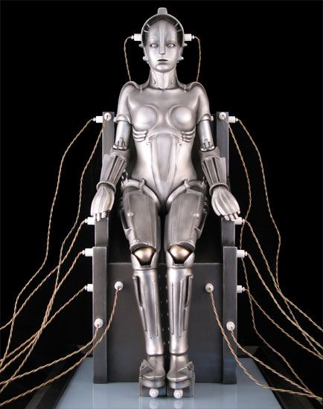
Questions and Problems (7)
The robot InMooV in the lab can be slightly modified to perform as this famous movie robot, Maria from Metropolis.
Fritz Lang’s Metropolis is a groundbreaking landmark of not just the Silent Age of cinema, but of all science fiction. Its merits and cinematic achievements are far too numerous to list here, and its influence on all of film after it almost too great to comprehend. Its Futurist/Deco production design is breathtaking to this day, and its dramatic social themes as relevant now as it was 88 years ago. It’s for these reasons that the Maschinenmensch, Maria’s robot double, can’t help but be ranked so highly, even though she doesn’t actually do much in the story, apart from making men fight to the death to win her favor. —S.W.
See the movie. What is the personality of this robot? How to design motions for it.
2. Write in LISP a new editor of motions for this robot, based on the theory presented in this set of slides. How to extend regular expressions to smooth and charming motions of this robot?
3. Use IGA to evolve the behaviors of this robot. Behaviors are specified as extended regular expressions with primitives of your choice.
4. The event expression generated by a IGA is next compiled to a state machine. Create a library of these machines.
This can be one quarter project

Slide 142
Questions and Problems (8)
Policemen were popular figures in pantomime theatres and puppet theatres.
Create a set of basic behaviors of a policeman for Jimmy robot.
Create a simple LISP program that will use the ideas from this lecture to combine the behaviors from point 1.

